Slide 1
Logistic Regression
Logistic regression is a type of regression analysis that models the probability of a certain class or event indicated by a dependent variable.
There can be one or more independent variables ("predictors").
For the binary-case (binomial, dichotomous) there are two categories such as positive/negative, healthy/sick.
The multi-class (multinomial, polychotomous) version is also called “softmax”. This is different than the ordinal case (with dependent variables that are ordered).

Slide 2
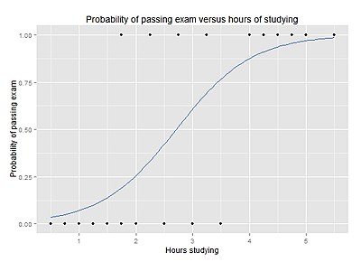
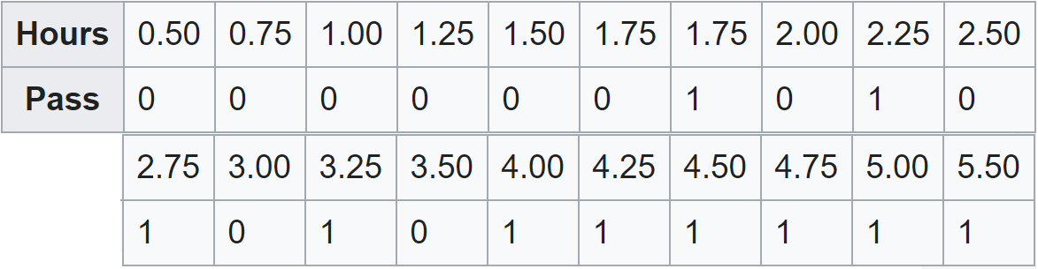
P(r|H)
What is the probability that a student passing with H=3 hours?
If the answer is 75% chance (3 out of 4 times), then the odds ratio is 3 to 1.
If the odds ratio is 2, then the probability of passing is 2/3.
H

Slide 3
Why not “just” regression?
In ordinary regression (OLS) :
y = w₀ + w×H and r = y + δ
Minimize MSE (sum of squares of δ values - residuals).
But when r ∈ {0, 1} :
The error is hard to define because the predicted values, y, can be greater than 1 or less than 0.
δ is not normally distributed because r takes on only two values.

Slide 4
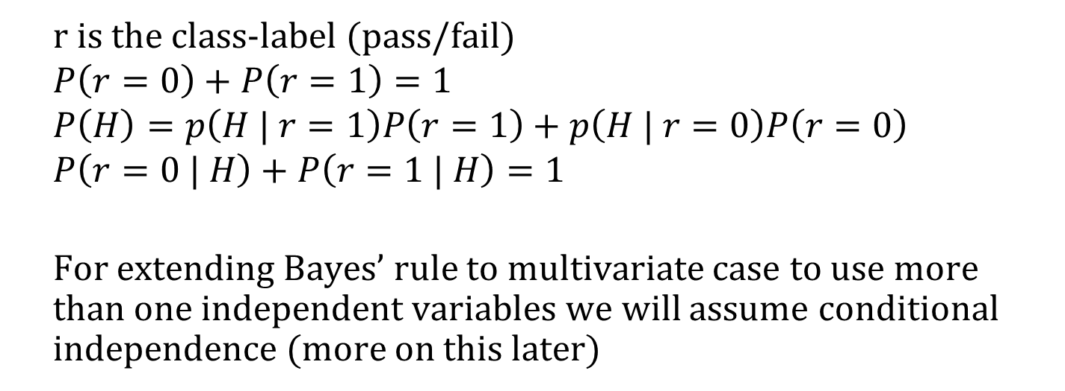
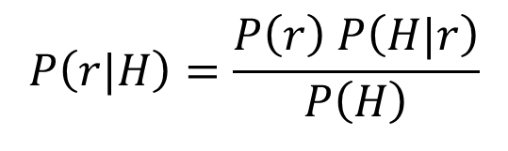
Bayes’ Rule
prior
likelihood
posterior
$$P\left(r|H\right)=\frac{P\left(r\right) P\left(H|r\right)}{P\left(H\right)}$$
evidence
r is the class-label (pass/fail)
$$P\left(r=0\right)+P\left(r=1\right)=1$$
$$P\left(H\right)=p\left(H | r=1\right)P\left(r=1\right)+p\left(H | r=0\right)P\left(r=0\right) \\ P\left(r=0 | H\right)+P\left(r=1 | H\right)=1$$
For extending Bayes’ rule to multivariate case to use more than one independent variables we will assume conditional independence (more on this later)

Slide 5
Generative vs Discriminative
To estimate the posterior probability using Bayes’ rule for classification, we typically assume the likelihood P(X|C=c) for each class c to follow a distribution (Gaussian, Bernoulli, or Multinomial) that generates the observations (independent variables). Naïve Bayes, Discriminant Analysis, HMM, Gaussian Mixture Models are examples of generative models. Variational Autoencoders are recently popular, they can be used for generating fake observations as well as classification.
Famous quote from Vladimir Vapnik in machine learning: "When solving a problem of interest, do not solve a more general problem as an intermediate step“.
In discriminative models, as we directly model the posterior probability we rely on fewer assumptions about the underlying data distribution. Logistic Regression is a discriminative classifier as well as SVMs, Decision Trees, Neural Networks, KNN and so on.

Slide 6
Logistic Regression
Uses regression to model the odds ratio or equivalently its logarithm.
Class-labels are not directly used as the dependent variable. The log-odds (the logarithm of the odds ratio) is modeled as a linear combination of the independent variables.
For the example problem: log(p/(1−p)) = w₀ + w×H
p is the probability of class-1, P(r=1 | H)
Range is [0, 1]
p/(1−p) is the “odds ratio”
Range is [0, ∞)
log(p/(1−p)): log odds ratio, or “logit”
Range is (-∞, +∞)

Slide 7
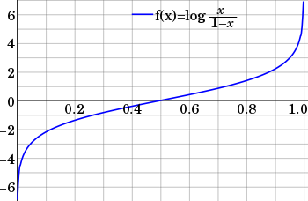
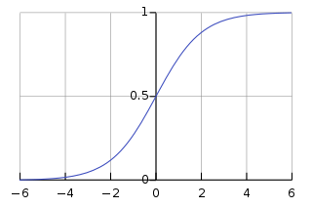
Logit Function
a= logit(p) = log(p/(1−p))
By simple algebraic manipulation,
p = exp(a) / (1 + exp(a))
p = 1 / (1 + exp(−a))
The inverse of logit is logistic sigmoid, “logsig”
p = logsig(a)

Slide 8
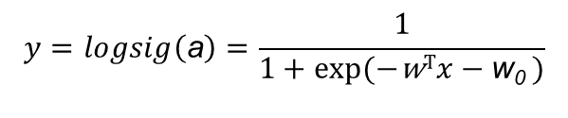

Remember what a perceptron does …
…for classification it returns 0 or 1* based on
[w^{T}x+w₀>0] (using a step function)
$$y$$
Do you remember we also said using sigmoid is a good idea? This discussion relates to the reason: [logsig(w^{T}x+w₀)>0.5])
a
w₀
w
x₀=+1
x₁=H
$$y=logsig\left(\text{a}\right)=\frac{1}{1+\text{exp}(−\text{w}Tx−\text{w}\text{0} )}$$
* using Iverson bracket notation

Slide 9
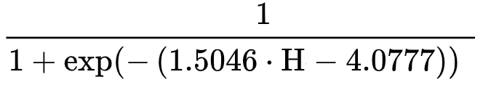
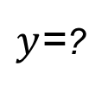
What is the probability
that a student passing
with H = 3 hours?
$y$=?
∫
-4.0777
1.5046
a = logit(p) = log(1/(1−p)) = 1.5046 × H − 4.0777
+1
3.0
Probability of passing exam,
p = 1/(1+exp(−a)) =

Slide 10
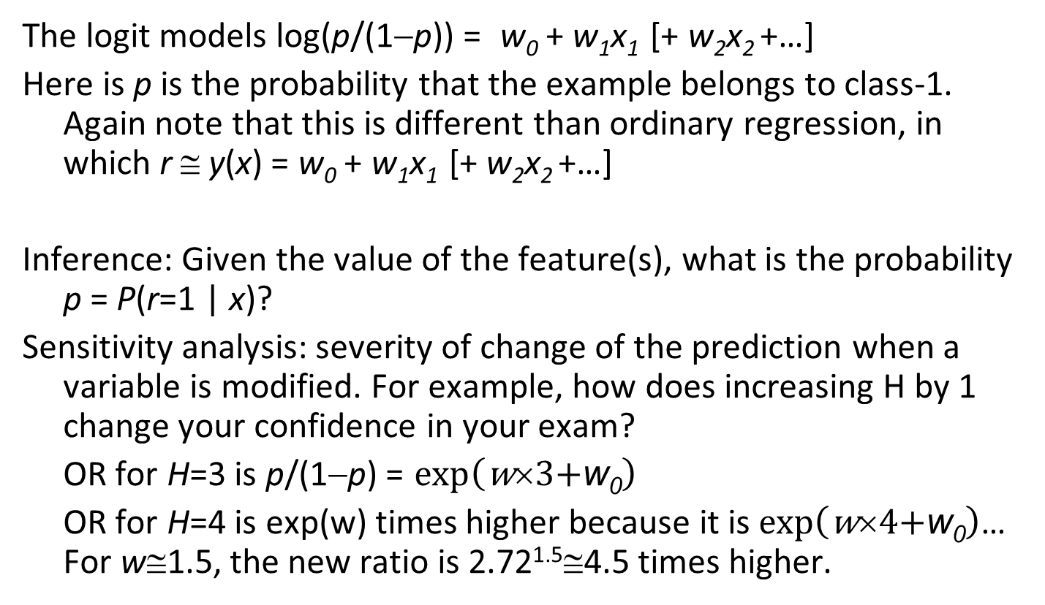
The Logistic Regression Model
The logit models log(p/(1−p)) = w₀ + w₁x₁ [+ w₂x₂ +…]
Here is p is the probability that the example belongs to class-1. Again note that this is different than ordinary regression, in which r ≅ y(x) = w₀ + w₁x₁ [+ w₂x₂ +…]
Inference: Given the value of the feature(s), what is the probability p = P(r=1 | x)?
Sensitivity analysis: severity of change of the prediction when a variable is modified. For example, how does increasing H by 1 change your confidence in your exam?
OR for H=3 is p/(1−p) = $\text{exp}\left(\text{w}×3\text{+}\text{w}\text{0}\right)$
OR for H=4 is exp(w) times higher because it is $\text{exp}\left(\text{w}×4\text{+}\text{w}\text{0}\right)$… For w≅1.5, the new ratio is 2.72^{1.5}≅4.5 times higher.

Slide 11
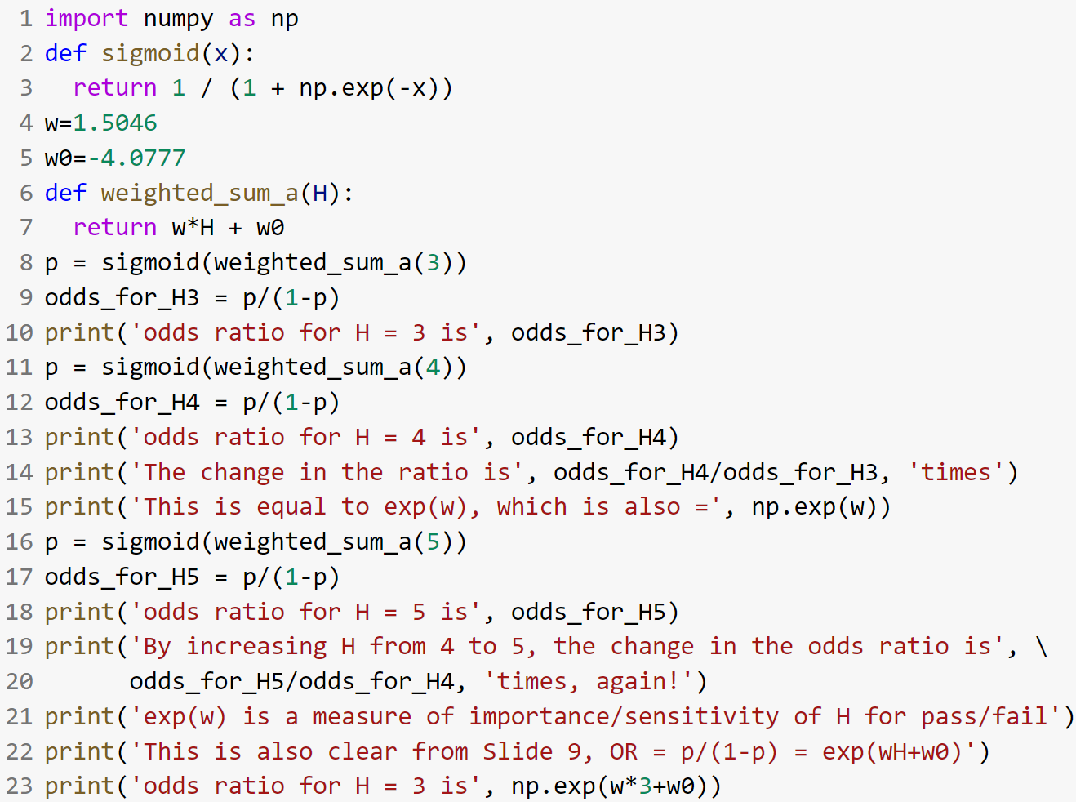
The Logistic Regression Model

Slide 12
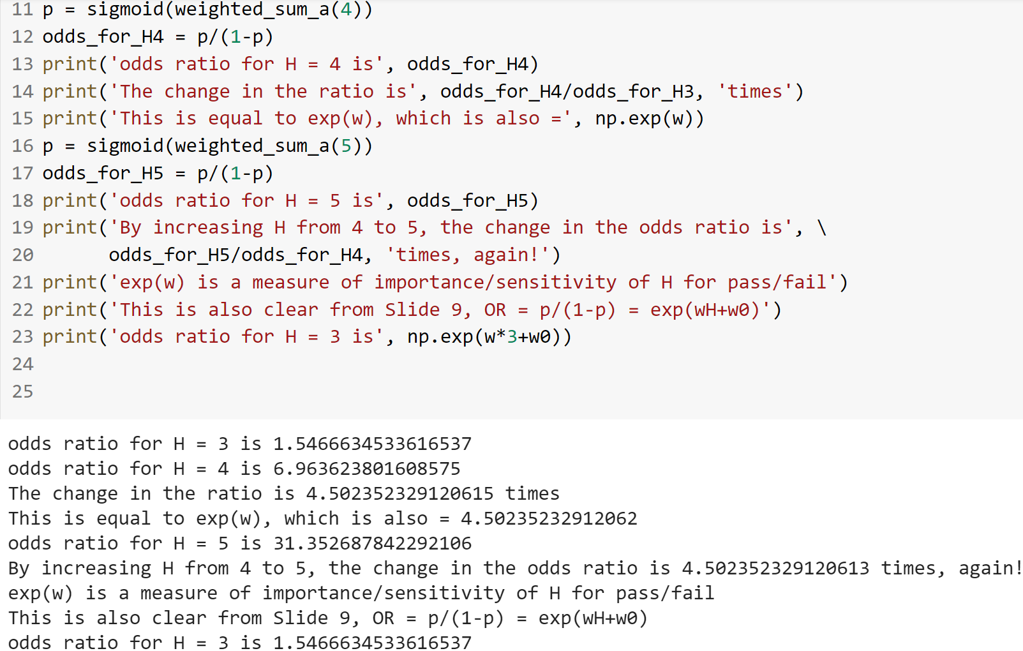
The Logistic Regression Model

Slide 13
Logistic Regression Optimization
We can now formulate the likelihood function and find the parameters (weights w and w₀) that maximize this likelihood.
Likelihood measures the goodness of fit of a statistical model to a sample of data for given values of the unknown parameters; for example, everyone you talk to after the exam complains about how bad it was, what are the chances that the mean of the distribution of the exam scores is 90? Or, some students complain but some others say it went great, what are the chances (likelihood) of having a standard deviation of only 2-3 points?
Typically, we maximize the log-likelihood.

Slide 14
Likelihood
Result of tossing a coin is ∈ {Heads,Tails}
Random variable r∈{1,0}
Sample: r = {r ^{t} }, for t = 1..N
For example, r = [1, 1, 1, 0, 1, 0, 1, 1, 0, 0]^{T} for N=10
What is the likelihood that the coin is biased such that it comes up as Heads 90% of the time?
0.9×0.9×0.9×0.1×0.9×0.1×0.9×0.9×0.1×0.1=0.0000531441
What is the likelihood that the coin is fair?
0.5¹⁰ = 0.0009765625
#{Heads}/#{Tosses} = (1/N) ∑_{t} r ^{t} = 0.6 has the maximum likelihood. But why? How do we reach that formula? For this special case, we can solve for it but in general this needs an iterative optimization method such as gradient descent, Newton’s method, etc.

Slide 15
Maximum Likelihood Estimation (MLE) in Machine Learning
Assume a good model and optimize the parameters so that those parameter settings (weights etc.) have the maximum compatibility with the observed data.
Find the optimal weights of a neural network (classification or regression)
Find the clusters in a dataset
Find distribution parameters

Slide 16
Maximum Likelihood Estimation (MLE) in Machine Learning
Given the dataset X={s^{t} }, where each example is in the form s^{t} =(x^{t},r^{t}), the likelihood of θ is:
l(θ|X) = P(X |θ) = ∏_{t} P(s^{t}|θ)
Log likelihood
L(θ|X) = log l(θ|X) = ∑_{t} log P(s^{t}|θ)
Maximum likelihood estimator (MLE)
θ* = argmax_{θ} L(θ|X)

Slide 17
Bernoulli Distribution
The Bernoulli distribution is the discrete probability distribution of a random variable which takes the value 1 with probability p and the value 0 with probability q = 1 − p
P(r ^{t} = 1 | θ = p) = p
P(r ^{t} = 0 | θ = p) = 1−p = q
A better formulation for mathematical operations needed for the derivations is:
P(r ^{t} | θ = p) = p^{r t} (1 ‒ p)^{(1 ‒ r t)}
For the coin tossing dataset, we do not have any input variables, just the class-labels… So, p is fixed and the task is to find the best constant for p that maximizes the likelihood.

Slide 18
MLE for Bernoulli Distribution
Log-likelihood is
L(θ|X) = ∑_{t} log(p^{r t} (1 ‒ p)^{(1 ‒ r t)})
= ∑_{t} [r ^{t} log(p) + (1 ‒ r ^{t})log(1 ‒ p)]
For this special (simple) case, we do not need an iterative optimization tool, we can take the derivative of the log-likelihood with respect to p and obtain the optimal solution to be p* = (1/N) ∑_{t} r ^{t} as intuitively expected.

Slide 19
MLE for Logistic Regression
We can view classification in machine learning as repeating Bernoulli trials with the parameter p that depends on the input variables (for example, 3 hours studying, H=3, gives p≅ 0.61 probability: One student studies 3 hours and pass but another student may study the same amount of time but end up failing, it is probabilistic!)
So we still have: P(r ^{t} | θ = p) = p^{r t} (1 ‒ p)^{(1 ‒ r t)}
But p is not fixed… it is a function of the input variables (for example H): p = 1 / (1 + exp(−wH − w₀))
Therefore, the task is to find the optimal w and w₀
Gradient descent is one way of doing that optimization that Perceptron uses. As you see in machine learning libraries Logistic Regression has other options (some are faster, some work mostly with big datasets) for the “solver”.

Slide 20
References
Python program that I wrote for demonstration: https://colab.research.google.com/drive/1pJA3iDK3Fbctdbu2mnVRK7OSchZoJuNq?usp=sharing
Ethem Alpaydin’s book, Chapters 3 and 4
https://www.cmpe.boun.edu.tr/~ethem/i2ml3e/
https://msu.edu/~kenfrank/introduction%20to%20logistic%20regression.pptx
https://en.wikipedia.org/wiki/Logistic_regression#Model_fitting

